Slide 1
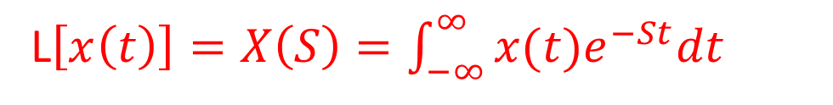
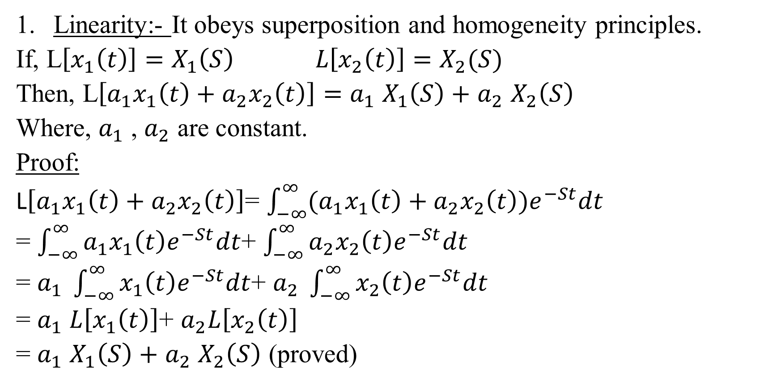
Properties of Laplace transform
Linearity:- It obeys superposition and homogeneity principles.
If, L$\left[x_{1}\left(t\right)\right]=X_{1}\left(S\right) L\left[x_{2}\left(t\right)\right]=X_{2}(S)$
Then, L$\left[a_{1}x_{1}\left(t\right)+a_{2}x_{2}\left(t\right)\right]=$ $a_{1}$ $X_{1}\left(S\right)+$ $a_{2}$ $X_{2}\left(S\right)$
Where, $a_{1}$ , $a_{2}$ are constant.
Proof:
L$\left[a_{1}x_{1}\left(t\right)+a_{2}x_{2}\left(t\right)\right]$= $\int_{−∞}^{∞}{(a_{1}x_{1}\left(t\right)+a_{2}x_{2}\left(t\right))e^{−St}dt}$
= $\int_{−∞}^{∞}{a_{1}x_{1}\left(t\right)e^{−St}dt}$+ $\int_{−∞}^{∞}{a_{2}x_{2}\left(t\right)e^{−St}dt}$
= $a_{1} \int_{−∞}^{∞}{x_{1}\left(t\right)e^{−St}dt}$+ $a_{2} \int_{−∞}^{∞}{x_{2}\left(t\right)e^{−St}dt}$
= $a_{1} L\left[x_{1}\left(t\right)\right]$+ $a_{2}L\left[x_{2}\left(t\right)\right]$
= $a_{1}$ $X_{1}\left(S\right)+$ $a_{2}$ $X_{2}\left(S\right)$ (proved)
L$\left[x\left(t\right)\right]=X\left(S\right)=\int_{−∞}^{∞}{x(t)e^{−St}dt}$

Slide 2
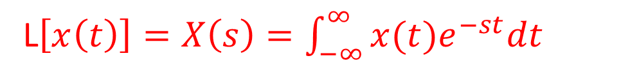
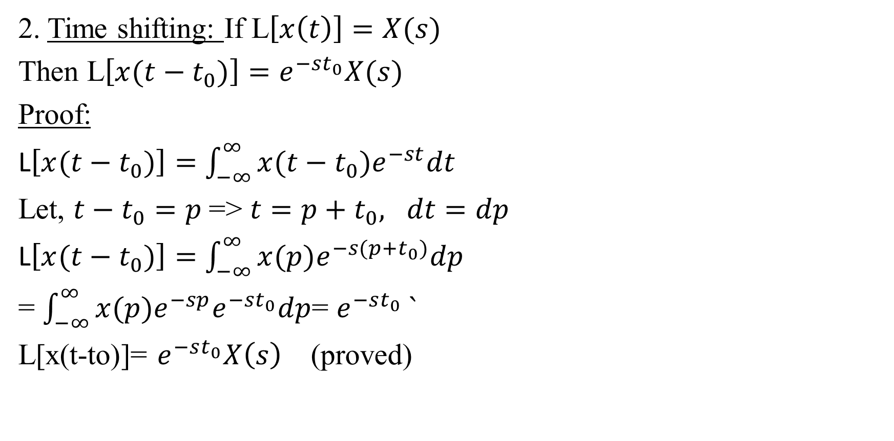
Properties of Laplace transform (Cont.)
2. Time shifting: If L$\left[x\left(t\right)\right]=X(s)$
Then L$\left[x(t−t_{0})\right]=e^{−st_{0}}X(s)$
Proof:
L$\left[x(t−t_{0})\right]=$ $\int_{−∞}^{∞}{x(t−t_{0})e^{−st}dt}$
Let, $t−t_{0}=p$=> $t=p+t_{0}, dt=dp$
L$\left[x(t−t_{0})\right]=$ $\int_{−∞}^{∞}{x(p)e^{−s(p+t_{0})}dp}$
= $\int_{−∞}^{∞}{x(p)e^{−sp}e^{−st_{0}}dp}$= $e^{−st_{0}} `$
L[x(t-to)]= $e^{−st_{0}}X\left(s\right)$ (proved)
L$\left[x\left(t\right)\right]=X\left(s\right)=\int_{−∞}^{∞}{x(t)e^{−st}dt}$

Slide 3
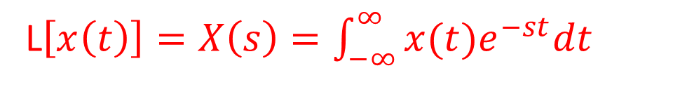
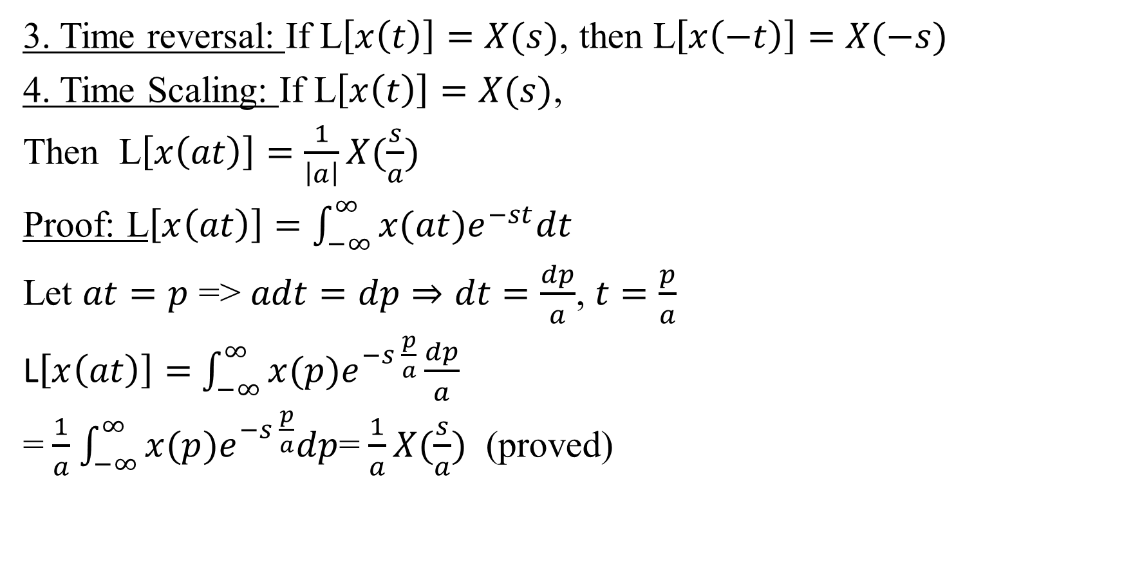
Properties of Laplace transform (Cont.)
3. Time reversal: If L$\left[x\left(t\right)\right]=X(s)$, then L$\left[x\left(−t\right)\right]=X(−s)$
4. Time Scaling: If L$\left[x\left(t\right)\right]=X(s)$,
Then L$\left[x\left(at\right)\right]=\frac{1}{\left|a\right|}X(\frac{s}{a})$
Proof: L$\left[x\left(at\right)\right]=$ $\int_{−∞}^{∞}{x(at)e^{−st}dt}$
Let $at=p$ => $adt=dp⇒dt=\frac{dp}{a}$, $t=\frac{p}{a}$
L$\left[x\left(at\right)\right]=$ $\int_{−∞}^{∞}{x(p)e^{−s \frac{p}{a}}\frac{dp}{a}}$
= $\frac{1}{a}$ $\int_{−∞}^{∞}{x(p)e^{−s \frac{p}{a}}dp}$= $\frac{1}{a}X(\frac{s}{a})$ (proved)
L$\left[x\left(t\right)\right]=X\left(s\right)=\int_{−∞}^{∞}{x(t)e^{−st}dt}$

Slide 4
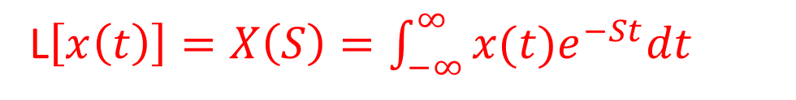
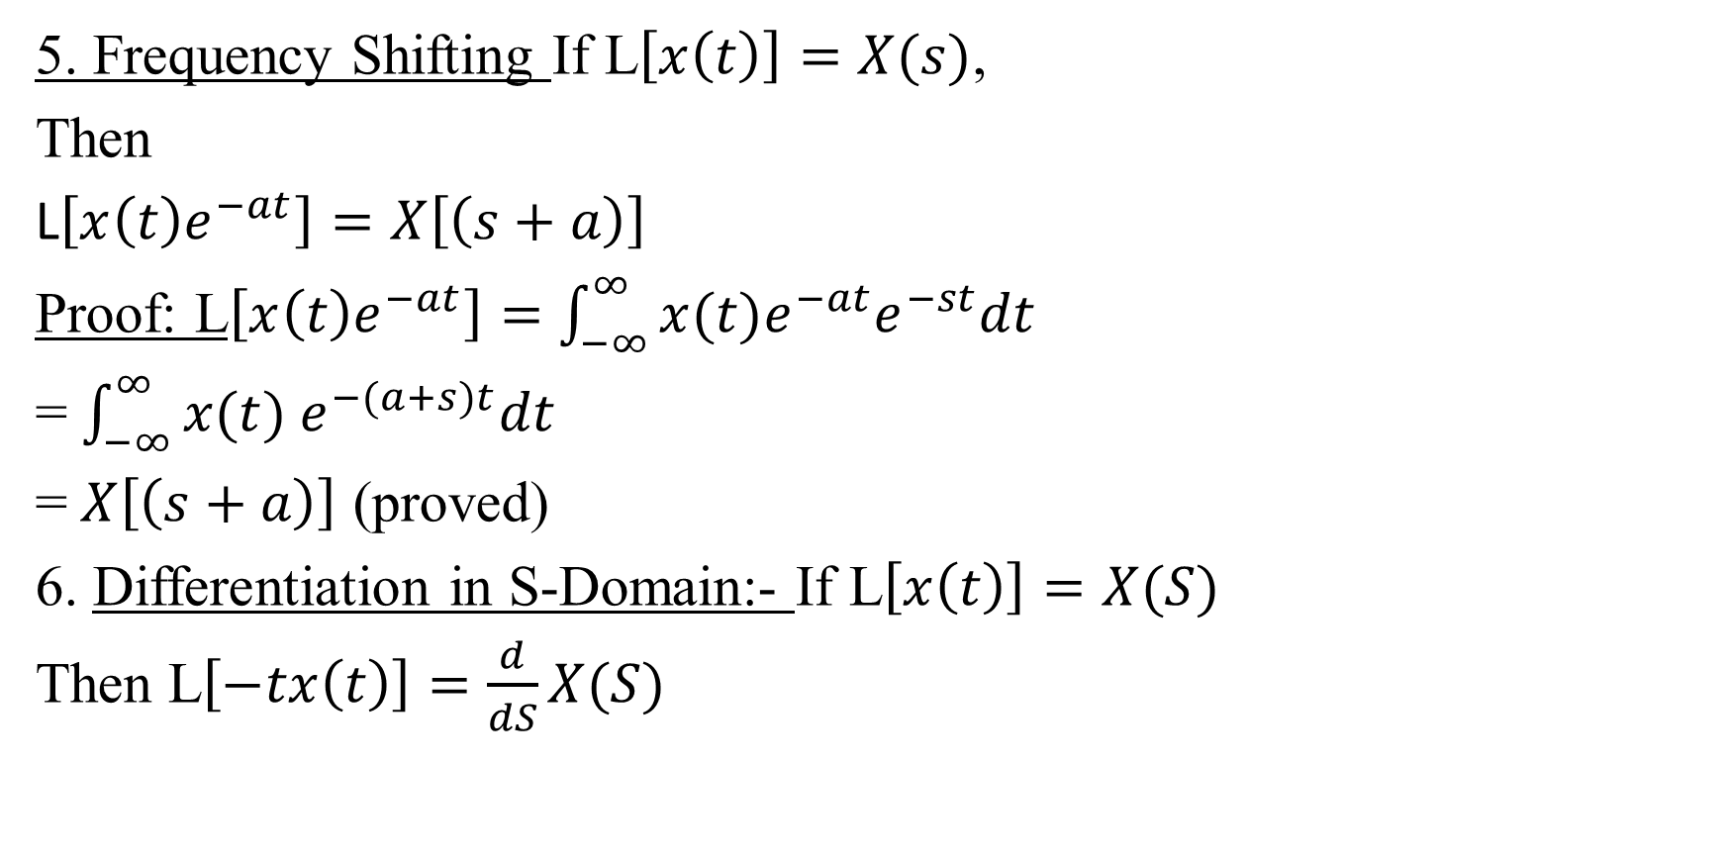
Properties of Laplace transform (Cont.)
5. Frequency Shifting If L$\left[x\left(t\right)\right]=X(s)$,
Then
L$\left[x\left(t\right)e^{−at}\right]=X\left[\left(s+a\right)\right]$
Proof: L$\left[x\left(t\right)e^{−at}\right]=$ $\int_{−∞}^{∞}{x(t)e^{−at}e^{−st}dt}$
= $\int_{−∞}^{∞}{x(t) e^{−(a+s)t}dt}$
= $X\left[\left(s+a\right)\right]$ (proved)
6. Differentiation in S-Domain:- If L$\left[x\left(t\right)\right]=X(S)$
Then L$\left[−tx\left(t\right)\right]=\frac{d}{dS}X(S)$
L$\left[x\left(t\right)\right]=X\left(S\right)=\int_{−∞}^{∞}{x(t)e^{−St}dt}$

Slide 5
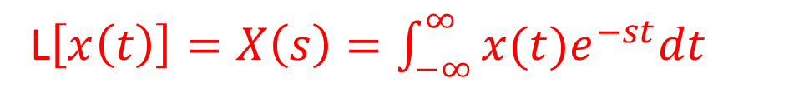
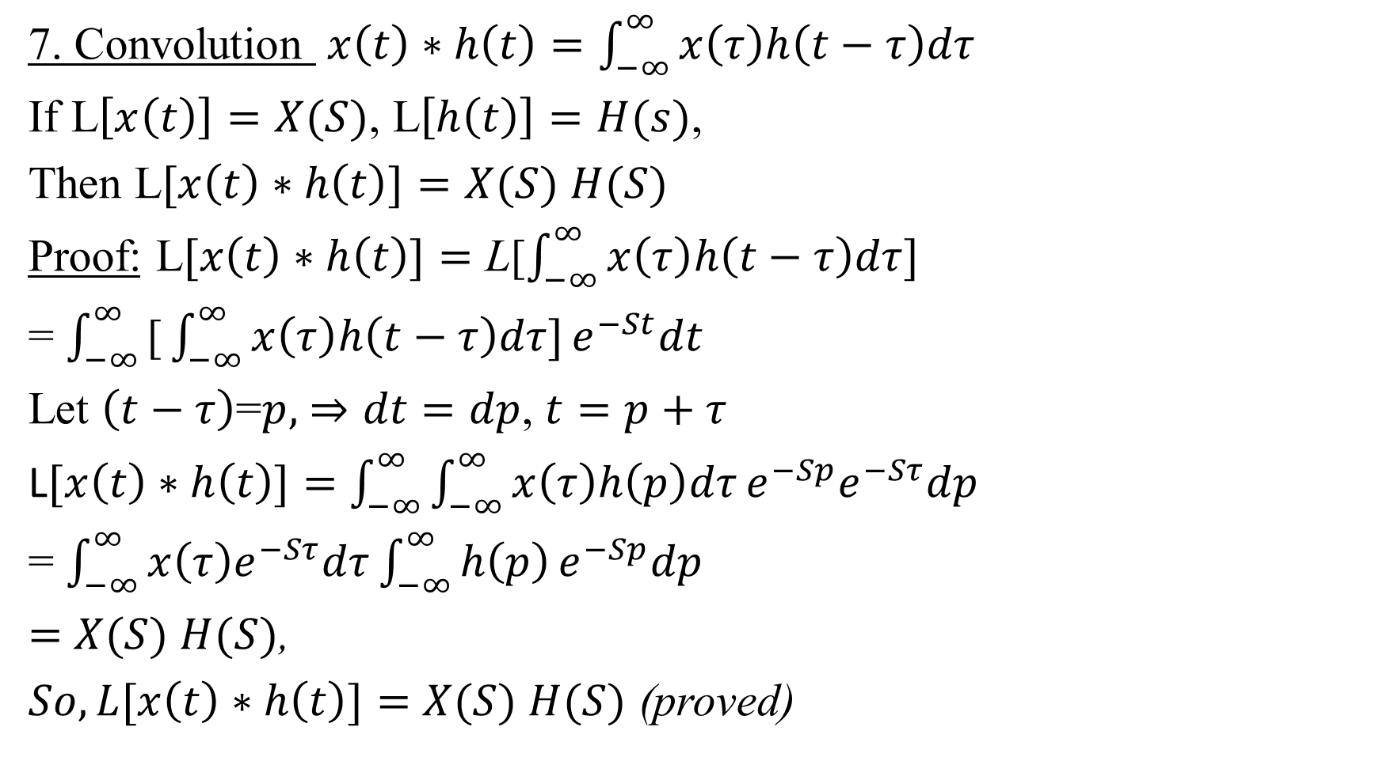
Properties of Laplace transform (Cont.)
7. Convolution $x\left(t\right)∗h\left(t\right)=\int_{−∞}^{∞}{x\left(τ\right)h\left(t−τ\right)dτ}$
If L$\left[x\left(t\right)\right]=X(S)$, L$\left[h\left(t\right)\right]=H(s)$,
Then L$[x\left(t\right)∗h\left(t\right)]=$ $X(S)$ $H(S)$
Proof: L$[x\left(t\right)∗h\left(t\right)]=$ L[$\int_{−∞}^{∞}{x\left(τ\right)h\left(t−τ\right)dτ]}$
= $\int_{−∞}^{∞}{\text{[}\int_{−∞}^{∞}{x\left(τ\right)h\left(t−τ\right)dτ]}e^{−St}dt}$
Let $\left(t−τ\right)$=$p,$ $⇒dt=dp$, $t=p+τ$
L$[x\left(t\right)∗h\left(t\right)]=$ $\int_{−∞}^{∞}{\int_{−∞}^{∞}{x\left(τ\right)h\left(p\right)dτ}e^{−Sp}e^{−Sτ}dp}$
= $\int_{−∞}^{∞}{x\left(τ\right)e^{−Sτ}dτ\int_{−∞}^{∞}{h\left(p\right)}e^{−Sp}dp}$
$=$ $X(S)$ $H(S)$,
$So, L[x\left(t\right)∗h\left(t\right)]=$ $X(S)$ $H(S)$ (proved)
L$\left[x\left(t\right)\right]=X\left(s\right)=\int_{−∞}^{∞}{x(t)e^{−st}dt}$

Slide 6
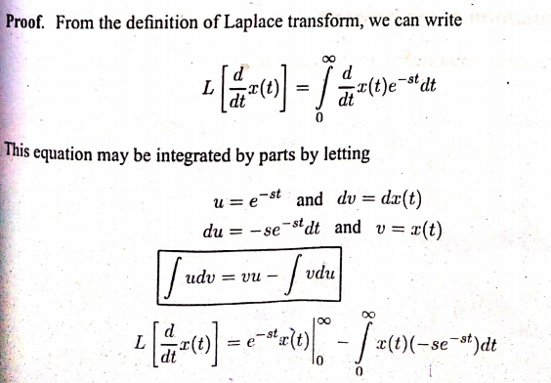
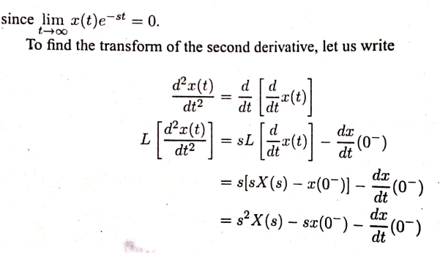
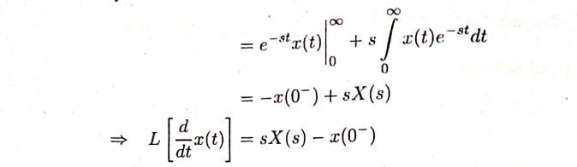
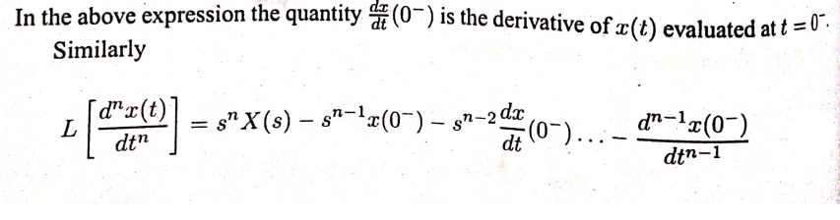

Properties of Laplace transform (Cont.)
8.Transform of derivatives:- If L$\left[x\left(t\right)\right]=X(s)$,
Then $F\left[\frac{d}{dt}x\left(t\right)\right]=SX(S)$ - x($0^{−}$)

Slide 7

Properties of Laplace transform (Cont.)
9. Initial value theorem
$$x\left(o^{+}\right)= \lim_{s→∞}{sX(S)}$$
10. Final value theorem
$$x\left(∞\right)= \lim_{s→o}{sX(S)}$$

Slide 8
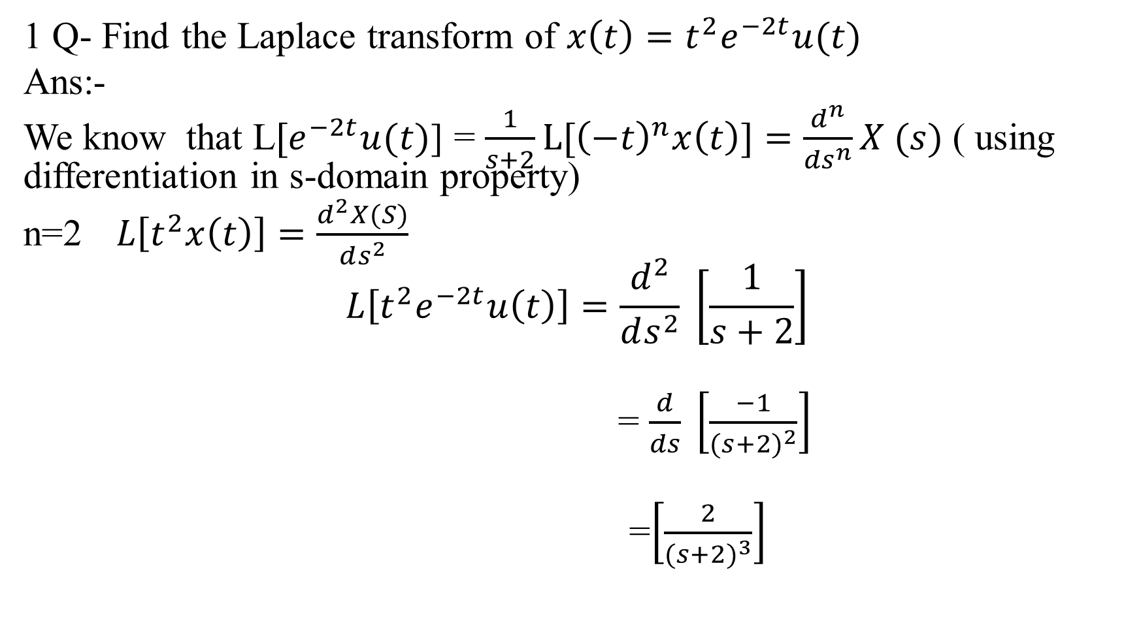
Problems
1 Q- Find the Laplace transform of $x\left(t\right)=t^{2}e^{−2t}u(t)$
Ans:-
We know that L$[e^{−2t}u(t)$] = $\frac{1}{s+2}L[{\left(−t\right)}^{n}x\left(t\right)]=\frac{d^{n}}{{ds}^{n}}X (s)$ ( using differentiation in s-domain property)
n=2$L\left[t^{2}x\left(t\right)\right]=\frac{d^{2}X(S)}{ds^{2}}$
$$L\left[t^{2}e^{−2t}u\left(t\right)\right]=\frac{d^{2}}{ds^{2}} \left[\frac{1}{s+2}\right]$$
= $\frac{d}{ds} \left[\frac{−1}{{(s+2)}^{2}}\right]$
=$\left[\frac{2}{{(s+2)}^{3}}\right]$

Slide 9
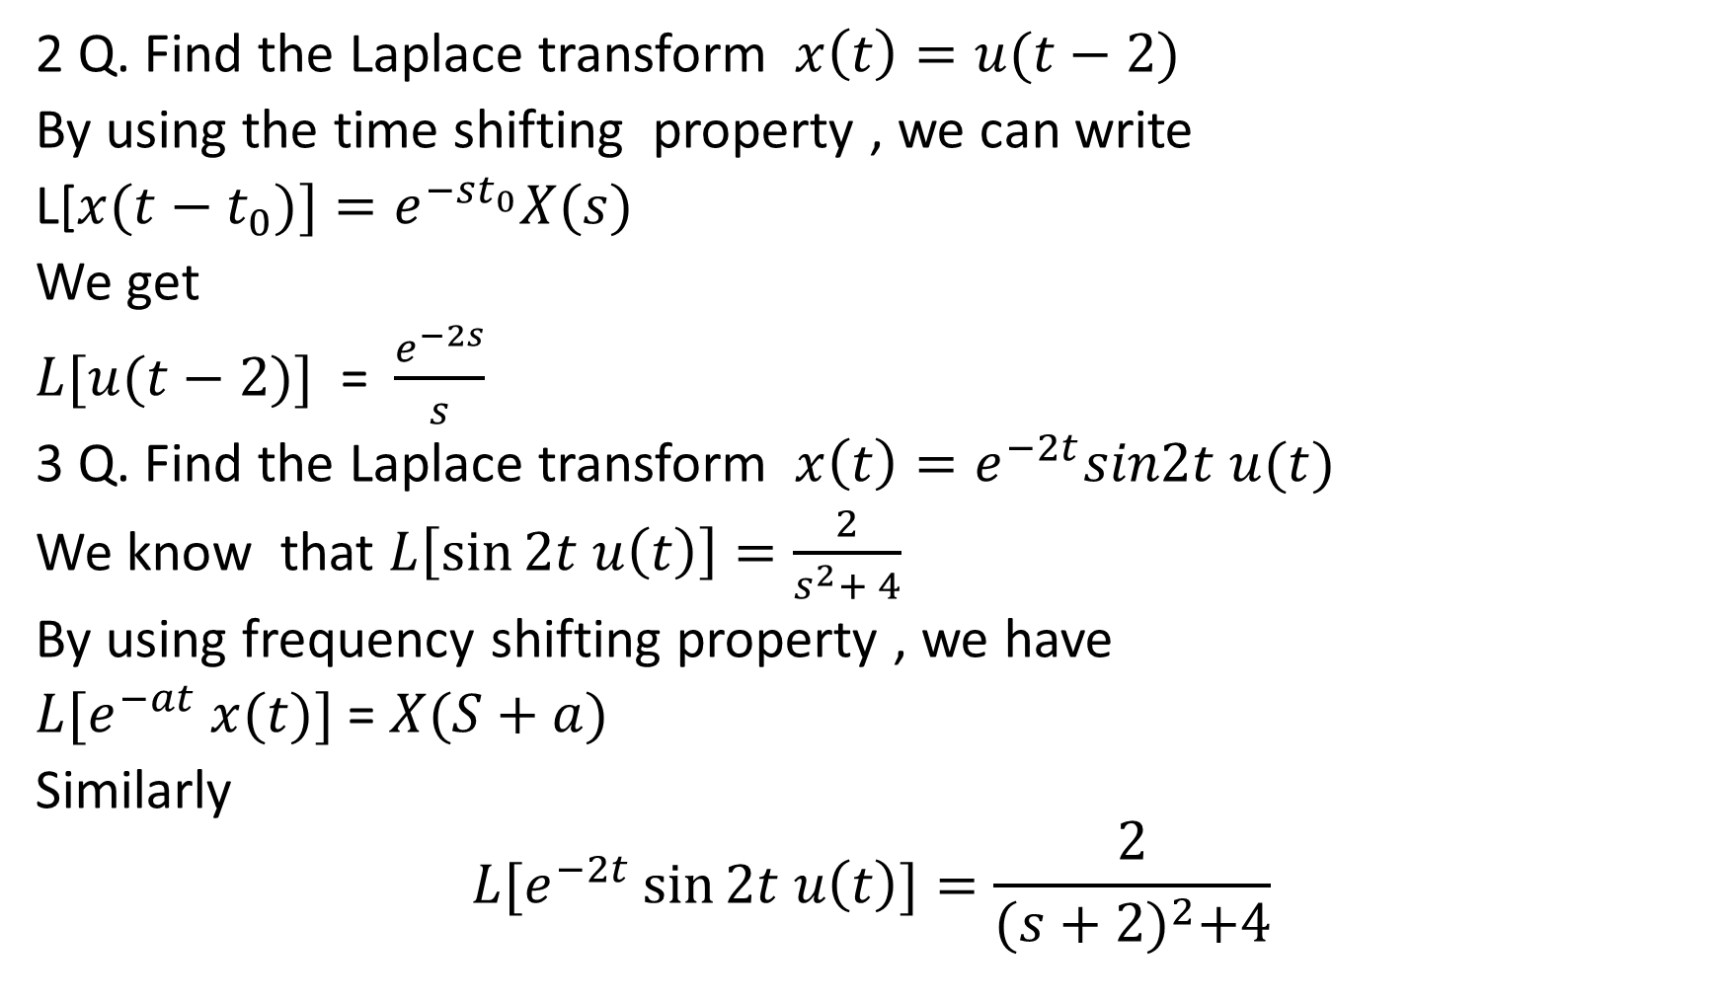
Problem (cont)
2 Q. Find the Laplace transform $x\left(t\right)=u(t−2)$
By using the time shifting property , we can write
L[$x(t−t_{0})]=e^{−st_{0}}X(s)$
We get
$L[u(t−2)]$ = $\frac{e^{−2s}}{s}$
3 Q. Find the Laplace transform $x\left(t\right)=e^{−2t}sin2t u(t)$
We know that $L\left[\sin{2t u\left(t\right)}\right]=\frac{2}{s^{2}+ 4}$
By using frequency shifting property , we have
$L[e^{−at} x(t)]$ = $X(S+a)$
Similarly
$$L[e^{−2t}\sin{2t u\left(t\right)]=\frac{2}{{(s+2)}^{2}+4}}$$

Slide 10
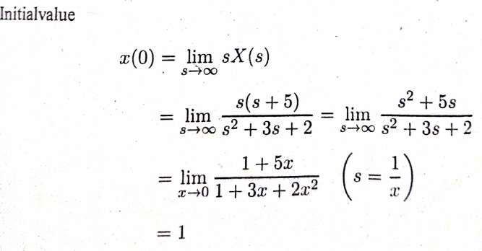
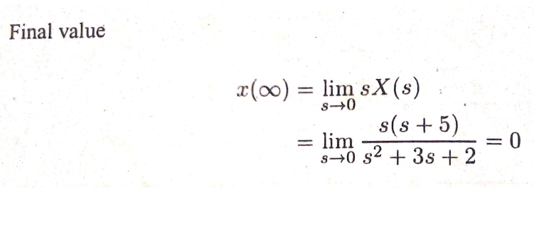

4 Q.Find the initial and final value
$$X\left(s\right)= \frac{s+5}{s^{2}+ 3s + 2}$$

